Slide 1
Intro to Exercise
CJ Cofrancesco
B.S. Exercise Science
M.S. Exercise Science & Nutrition
Notes:
Welcome to the first

Slide 2
Overview
What is exercise?
What are the benefits of exercise?
Why exercise?
My thoughts on the New Beginnings Fitness Challenge and my classes?
Notes:
The questions we will be able to answer at the end of this presentation

Slide 3
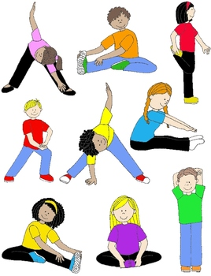
Exercise is. . .
Terminology Overview
Physical Activity, Fitness, ADL’s, Exercise
Stress, Overtraining, Rest
Types of Exercise
Cardio
Resistance
Flexibility
Balance & Coordination
Training Model
FITT-VP
Goals of Training
Notes:
Physical activity is defined as any bodily movement produced by the contraction of skeletal muscles that results in a substantial increase in caloric requirements over resting energy expenditure.
Fitness is generally defined as the ability to carry out daily tasks with vigor and alertness, without undo fatigue, and with ample energy to enjoy leisure-time pursuits and meet unforeseen emergencies.
Activities if Daily Living are essential and routine tasks that individuals can perform without assistance. Ambulating (or walking independently), eating, getting dressed, personal hygiene, control bladder and bowl functions, and going to the bathroom are typically considered the 6 essential functions. There are other types of ADLs that include other functions such as cleaning, cooking, using transportation, and more, but these ADLs are not considered as importance.
Exercise is defined as planned, structured, and repetitive bodily movement done to improve and/or maintain one or more components of physical fitness.
Stress is defined as the body’s response to a particular stimulus called a stressor. In exercise a stressor is purposefully introduced to exert the body above normal, everyday function. This makes the work/exercise more challenging but as a result the body can adapt and grow. The is known as the principle of overloading.
Overtraining is the result is overloading the body too much and/or to often and results in fatigue, a decline in performance, and increases the potential for injury.
Rest is defined as a period of time without any training, typically 24 hours from the previous session. Resting essential in exercise, during this time the muscles are able to rebuild and grow, let your body and mind adapt, and reenergize yourself for both the next workout and next day.
The primary physical activity recommendations from 2008 recommend that individuals participate in a minimum of 150 minutes of moderate aerobic activity per week or 30 minutes 5 days a week. In addition, a minimum of 2 days of resistance training and 2 days of flexibility training are also recommended.
Cardio or aerobic exercise primarily engages the cardiovascular and respiratory systems. This type of exercise gets your heart rate up when compared to being at rest (think sitting in a chair) and keeps it up for prolonged periods of time.
Resistance exercise aims to improve muscular fitness through the use of resistance to the muscles (think using dumbbells). It involves activities that overload the muscles and culminates in higher-than-normal workloads

Slide 4
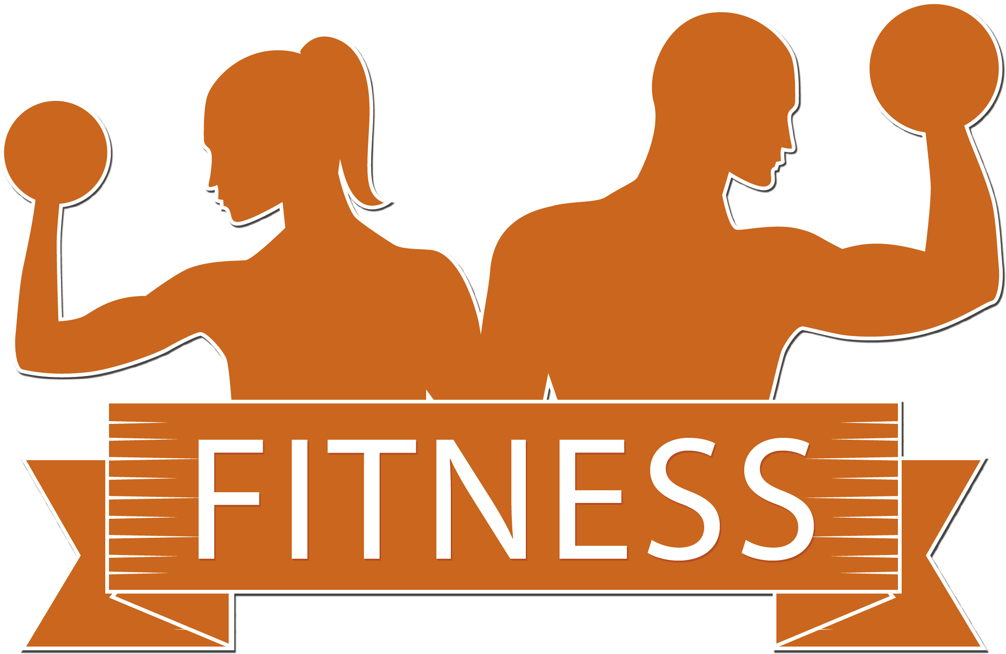
Training Model
Frequency
Intensity
Type
Time
Volume
Progression
Notes:
Frequency: how often we train – think number of days per week or number of times per day
Intensity: how hard we train – typically broken into 3 categories, low, moderate, and vigorous. Also perceived on a scale of 1 to 10 how hard are you working right now. Intensity can be measure by taking heart rate. The higher the heart the harder the individual is working. Everyone has a recommended target heart rate range based on age, their current level of fitness, and health
Type: The mode of exercise – cardio, resistance (endurance or strength), balance, flexibility,
Time: The length of time your total work out is
Volume: This is the numbers of sets and reps or time you do per exercise. The more you do the greater your total volume is.
Progression: The principle of progression states that as your body adapts to the fitness routine the workout should get easier, so to continue to gain health benefits from exercise the workout should increase in difficulty over time and in moderation.
Everyone is different. People don’t fit into the same mold. Just like we all have different tastes, things we like and dislike to do. In fitness the same is true of our bodies and our development. Look at people sitting near you. They will all grow and develop differently from you. What you can do to enjoy exercise and reap the best possible benefits exercise has to offer is focus on what you can do and what you want to accomplish.

Slide 5
Exercise is important because. . .
Improvements in Cardiovascular & Respiratory Function
Increased maximum O2 uptake
Increased efficiency in O2 usage
Decreased HR & BP while exercising at a given intensity
Reduction in Cardiovascular Disease Risk Factors
Decreased resting HR & BP
Decreased total boy fat
Decreased insulin needs and improved glucose tolerance
Decreased inflammation
Decreased Morbidity and Mortality
Other Benefits
Notes:
The health benefits are:
Decreased Morbidity & Mortality – lower death rates from Coronary Artery Disease, and lower incidences rates of cardiovascular disease, coronary artery disease, stroke, Type 2 diabetes, metabolic syndrome, osteoporotic fractures, cancer of the colon and breast, and gallbladder disease.
Other benefits – decreased anxiety and depression, improved cognitive function, improved physical function and independent living, improved feelings of well being, improved performance of work, recreational activities, and in sports, reduced risk of falling and fall related injuries in older individuals, prevention or mitigation of functional limitation in older adults, and is an effective therapy for many chronic diseases in older adults

Slide 6
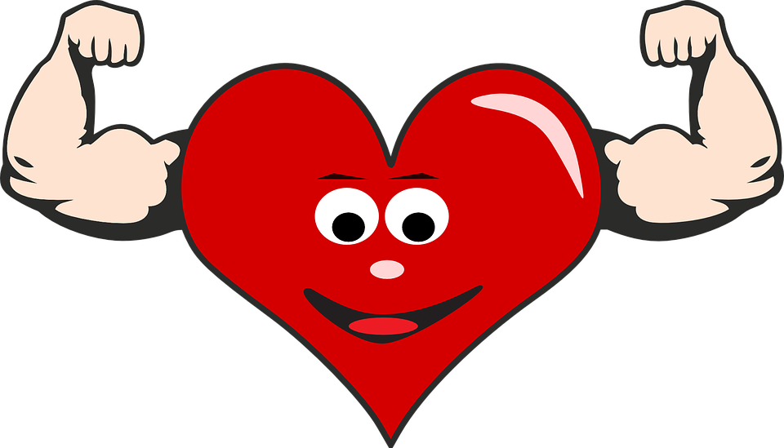
The reason we Exercise is. . .
To increase longevity of life
To decrease risk of injury and/or illness
To gain health benefits
To be able to complete ADL’s comfortably
To be comfortable in one’s own body
To challenge oneself
To have fun
Notes:
There are many reasons to exercise, here are a few. . .

Slide 7
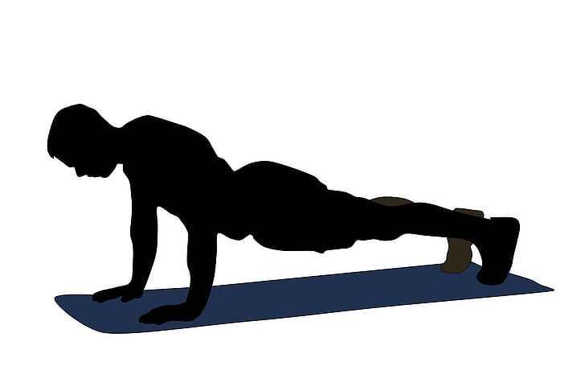
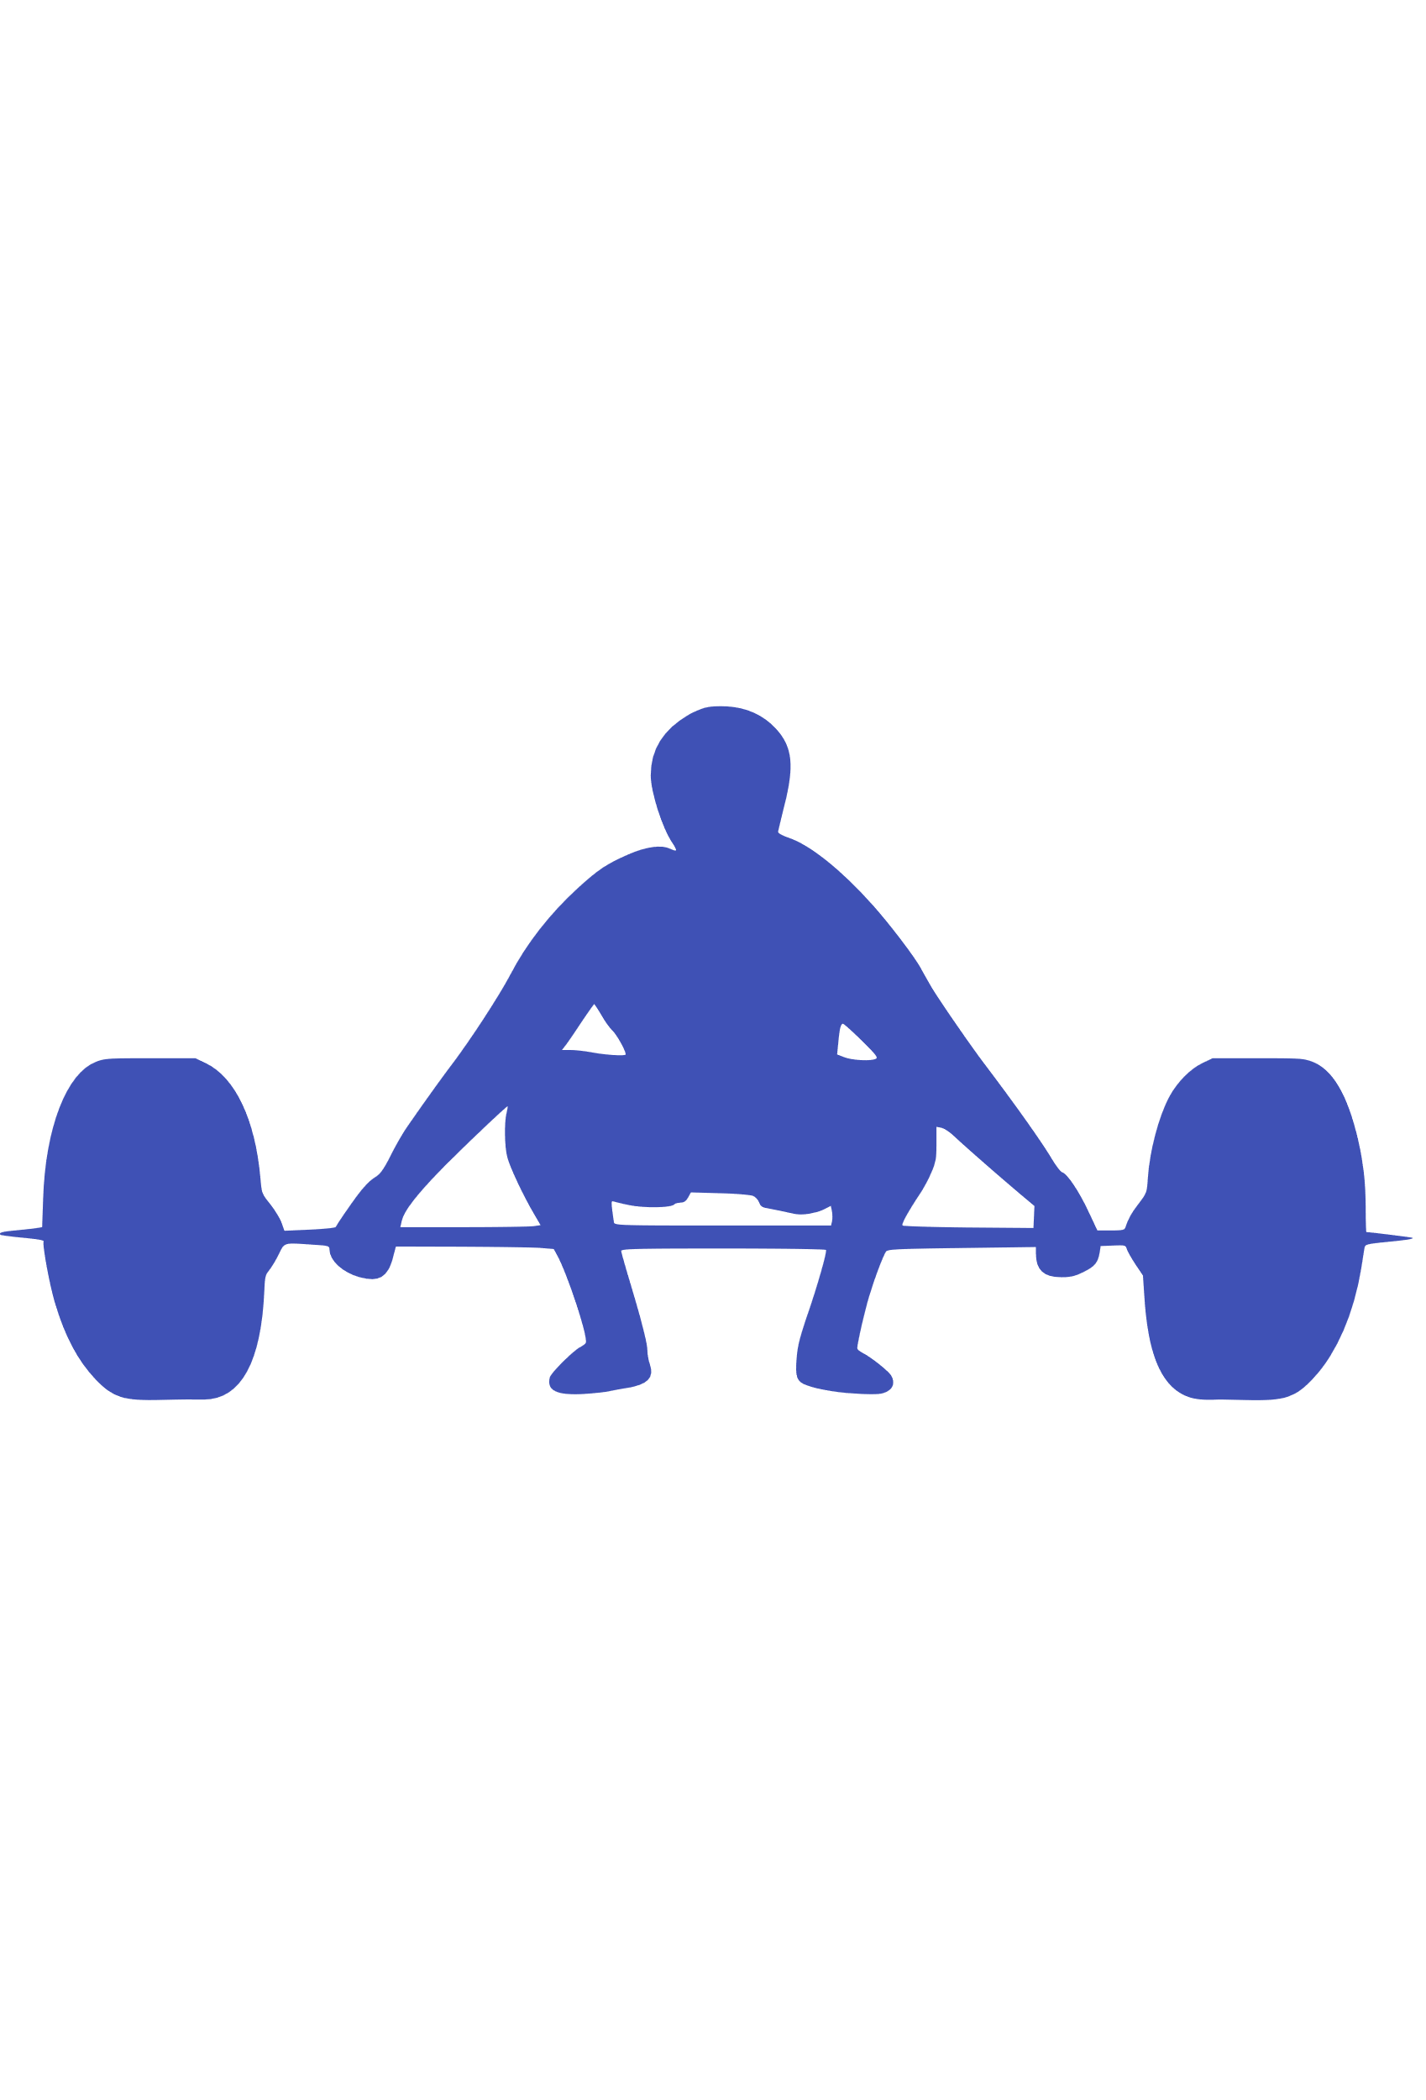
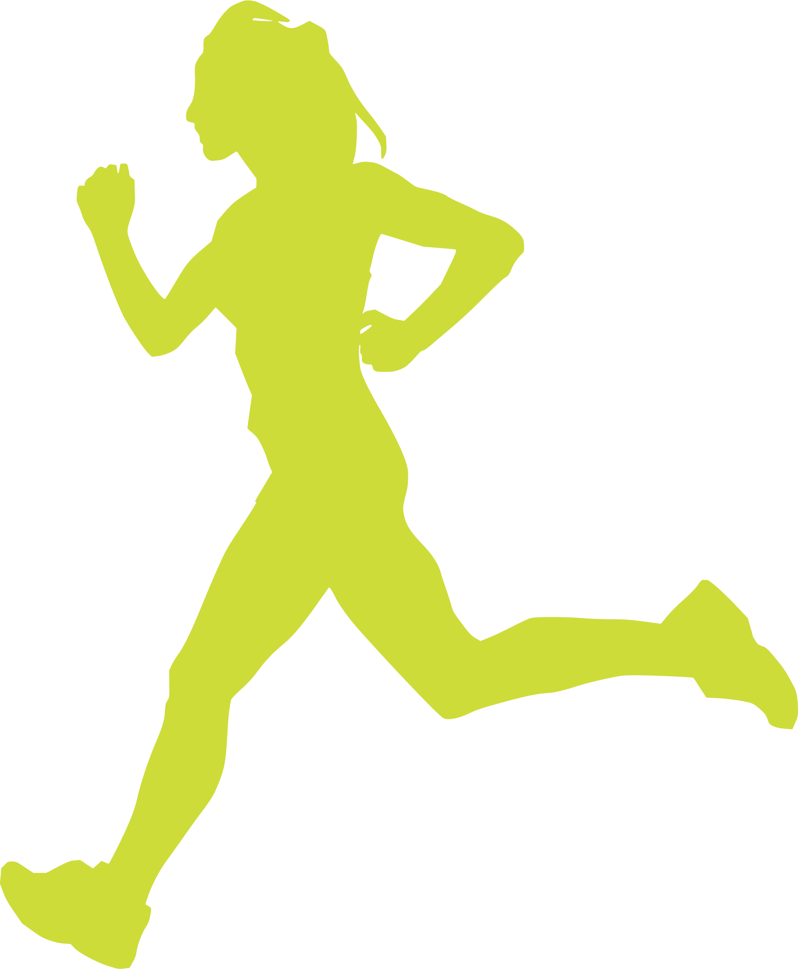
Goals of Resistance Training
Hypertrophy
Endurance
Strength
Power
Speed
Notes:
Hypertrophy is the increase in muscle fiber cross sectional aera that results in an increase in muscle volume and mass.
Endurance is the muscle’s ability to continue to perform successive exertions or repetitions against a submaximal load
Strength refers to the muscle’s ability to exert a maximal force on one occasion
Power is the muscle’s ability to exert force per unit of time, the rate at which force can be exerted
Speed is the ability to move all or part of the body as quickly as possible. Typically there are thought to be five types of speed: reaction, movement, acceleration, locomotion, and endurance.

Slide 8
New Beginnings Fitness Challenge Overview
Program was 6 weeks long
Week’s 1 & 6
Week’s 2 through 5
Fitness Testing Protocol
4 Stage Balance Test
30 Second Arm Curl Test
30 Second Chair Sit to Stand Test
10 Meter Walk Test
SMART Goal Setting
Fitness Classes Offered
Notes:
The New Beginnings Fitness Challenge started Tuesday January 17th and concluded on Friday February 24th.
The first and last week of the program was strictly for fitness testing. Every individual performed the same 4 fitness tests; the 4-stage balance test, the 30 seconds arm curl test, the 30 second sit to stand test, and the 10-meter walk test.
Demonstrate & explain each test as well as the goal/what data I was hoping to collect. The balance test was used as criteria to determine who was able and not able to participate in one of the upcoming classes.
From the 2nd week through the 5th week, we focused on exercising and improving our speed, strength and balance. 4 weeks of classes were offered here at the Senior Center. Classes ran by other instructors include: Circuit Training 101 with Christina Murphy, Active Older Adult with Colleen Villano, Taking Shape with Maureen McGruire, Tai Chi with Kathy Trusdale, Chair Yoga with Joanne Brady, and the daily walk with our very own KimAnh Vu.
I ran Better Balance which is an entry level class that focuses on developing leg and core strength and improving balance. All exercises are body and use a chair as an assisted device. DEMONSTRATION.
I also ran two additional classes during this time frame the first of which was Advanced Balance class where we had 6 individuals participate. This class used the steps and risers which allowed us to further develop leg and core strength, speed, and improve balance. DEMOSTRATION.
The last class was AM Arms which everyone was allowed to participate. We used no weight, 2, 3 and 5 lbs dumbbells. This class focused on shoulder, arm and upper back strength related exercises. DEMONSTRATION.
On the next few slides we will be looking at the data collected from the program.

Slide 9
Notes:
13 individuals participated in the NEW Beginnings Fitness Challenge, only 11 did the pre and post fitness testing. During the 4 week period a total of 34 classes were offered. The average number of classes attended during the 4-week workout period was 11 classes. The range of classes participated by individuals ranged from a total of 2 classes to 20 classes.

Slide 10
Notes:
The data shown above is the average length of time or repetitions accomplished during the Pre-Fitness Testing.
The average length of time participants were able to maintain balance in stages 1 and 2 were 10 seconds, the maximum time needed to complete the test. For stage 3 the average length of time was 9.5 seconds and for stage 4 on both the left and right foot roughly 8.5 seconds, with the right foot able to slightly maintain balance longer.
During the 30 second arm curl test the left arm average 13.7 curls while the right arm average 12.9 curls, indicating that from participants they are slight stronger in the left arms. The highest number of reps in the left arm was 20 while the highest in the right arm was 19 reps, both of which was accomplished by the same individual. The lowest numbers of reps accomplished was 8 in the left arm and 7 in the right, again both accomplished by the same individual.
The average number of chair squats performed in the 30 second chair sit to stand test was about 10.5. The highest number reached was 14 and the lowest was 7 reps.
The average time it took to complete the 10-meter walk test was 5.9 seconds. The slowest time was 7.63 seconds and the fastest was 5.06 seconds. The average was speed was 1.34 meters per second or 4.41 feet per second. This number may not seem big, but according The Journal of Geriatric Physical Therapy, walking is considered the sixth vital sign². Being able to maintain minimum walking speed of 1 m/s increases independence in complete activities of daily living, decreases the chances of hospitalization, decreases the chances of having an adverse event, and increases the ability to cross the street independently.

Slide 11
Notes:
The data shown above is the average length of time or repetitions accomplished during the Post-Fitness Testing after 4 weeks of exercise classes offered at the Senior Center.
The average length of time participants were able to maintain balance in stages 1 and 2 remained at 10 seconds, which to quickly remind you was the maximum amount of time the position needed to be held for. Stage 3 improved to an average of 10 seconds. In stage 4 the left increased to an average of roughly 9 seconds, while the right foot remained at roughly 8.5 seconds. Overall, on average balance either remained the same or improved!
In the 30 second arm curl the average for the left arm was 16.7 reps while in the left arm the average was 15.8 reps. The lowest reps were 10 in the left and 9 in the right, both for the same individual. The highest number of reps were 21 reps in the left (tied between two individuals, and 20 in the right arm (one of the two individuals). Again, on average our participants were strong in their left arms.
In the 30 seconds chair sit to stand test the average numbers of reps was 12. The lowest was 8 reps and the highest was 15.
Walking time in the 10-meter walking test averaged 5.73 seconds. The slowest time was 6.51 seconds, and the fastest time was 4.93 seconds. The average walking speed was 1.38 m/s or 4.55 ft/s.

Slide 12
Notes:
Taking the previous 2 graphs and subtracting the differences of the Post or second fitness test from the Pre or first fitness test will result in the average increase in each category. For this section I did not include the 4-stage balance test.
Left arm strength increased by 26%, right arm strength by 27%, leg strength by 17%, walking speed by 3%, and lastly walking speed decrease by 3%, the only test where we want to see a decrease, because a low time in cardio fitness tests is the goal.

Slide 13
Notes:
Here is a quick look at our 13 participants anonymously.
On the graph 1.00 should be the minimum goal. 1.00 equals being able to maintain one’s fitness level, or alternatively there was no decrease in one’s fitness level. The exception on this graph being the green bar which represents walking time. When talking about speed a lower time is always better.

Slide 14
Closing Remarks
Better Balance
AM Arms
Core Training
Cardio w/ CJ
Advanced Balance
CJ’s Circuit Circus
Snowflake Challenge
New Beginnings Fitness Challenge
Notes:
Talk about the fitness classes I’ve run and my thoughts
What I would like to see going forward

Slide 15
References
1. Riebe, Deborah, et al. ACSM's Guidelines for Exercise Testing and Prescription. Wolters Kluwer, 2018.
2. Fritz, Stacy, and Michelle Lusardi. White Paper: "Walking Speed: The Sixth Vital Sign" : Journal of Geriatric Physical Therapy. 2009, https://journals.lww.com/jgpt/fulltext/2009/32020/white_paper___walking_speed__the_sixth_vital_sign_.2.aspx.

Slide 16
Questions

Slide 17
Future Presentation
Join us in June for another health and wellness presentation: Exercise & Aging

